Slide 1
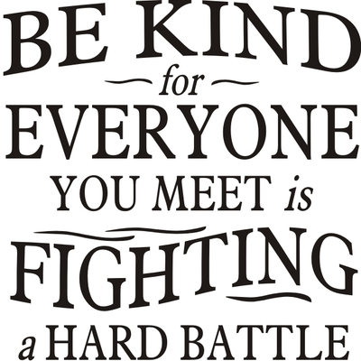
Help….I’m Being Bullied
Conflicts happen all the time, to everyone about anything.
Conflict is a normal part of life!
Examples of Conflicts
You want to play soccer, your friend wants to play basketball.
You don’t like another student and that student does not like you.
You call someone a mean name, they call you a mean name back.
You spread a rumor about someone after they spread a rumor about you
Conflict Behaviors
Definition: A problem between two or more people. Two-sided
But are you really?
Did it happen only once or twice? (Then its not bullying)
Did you do it back? (Nope…not bullying)
Did the person intend to hurt you? (If the answer is no…that is not bullying)
Report all Bullying Behaviors to a Caring Adult!
Kind Behaviors
Definition: Friendly, generous or warm-hearted behaviors toward another person.
Examples of Kind Behaviors
Helping someone
Holding the door
Saying “Hello”
Giving a compliment
Inviting someone to sit by you
Has it happened repeatedly and you have not participated in the bullying behaviors too?
(Then it may be bullying)

Slide 2
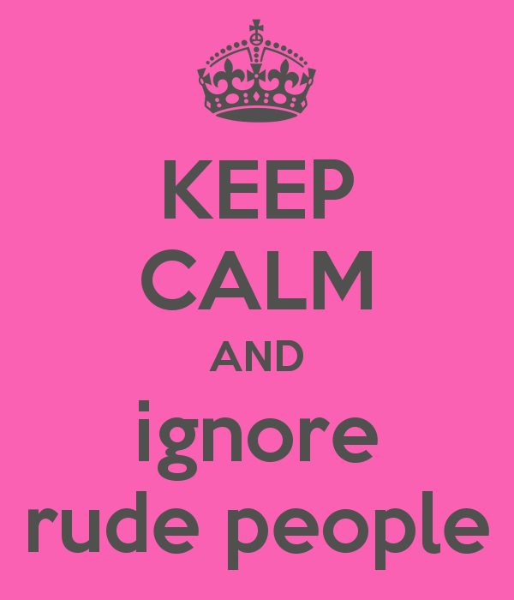
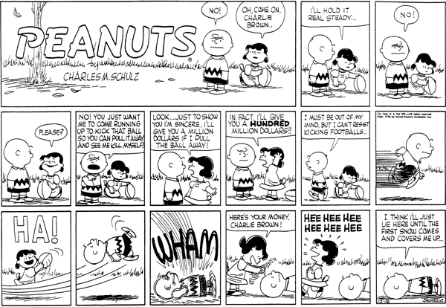
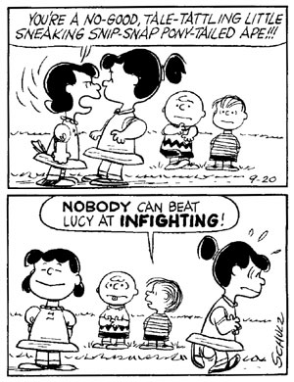
Mean Behaviors
Definition: Saying or doing something to hurt someone on purpose (1-2 times)
Examples of Mean Behaviors
Criticizing someone's appearance or intelligence
Saying or doing something in anger toward someone
Raising your voice at someone
Bullying Behaviors
Definition: When one or more people repeatedly harm, harass, intimidate, or exclude others over time. There is an imbalance of power and it is one sided.
Examples of Bullying Behaviors
Physical (hitting, kicking, shoving, choking, tripping)
Verbal (threats, namecalling, embarrassing someone on purpose).
Relational (leaving others out on purpose, rumors, gossip, ignoring, “I’m not your friend if….”, “If you are her friend…I’m not your friend.”
Cyber (using technology to do any of the above behaviors).
If you find yourself in a true bullying situation – always get help!
Rude Behaviors
Definition: Saying or doing something that hurts someone else without mean intentions.
Examples of Rude Behavior
Shortcutting
Bragging
Not saying “hi” back
Someone not holding the door

